Slide 1
OOP Presentation
By Guillem Soto

Slide 2
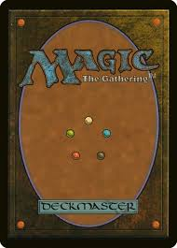
Object

Slide 3
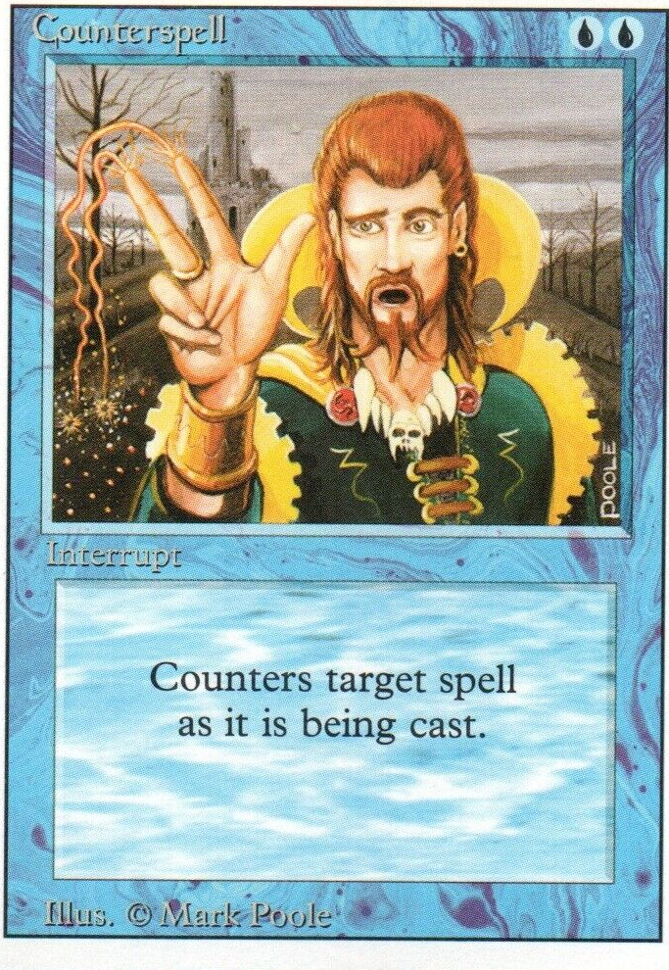
Instance

Slide 4
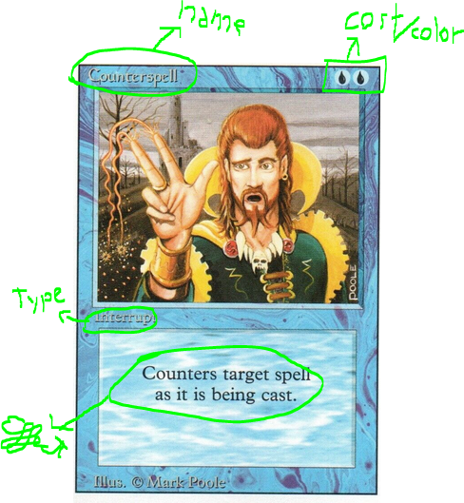
Class

Slide 5
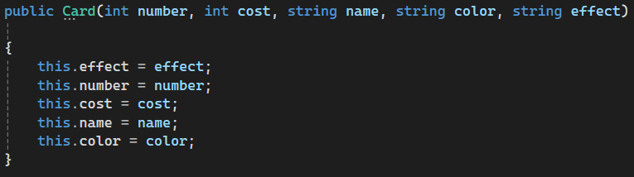
Construction

Slide 6
Encapsulement
Public: Every class
Private: Only the class it’s in
Protected: All classes that share a superclass

Slide 7
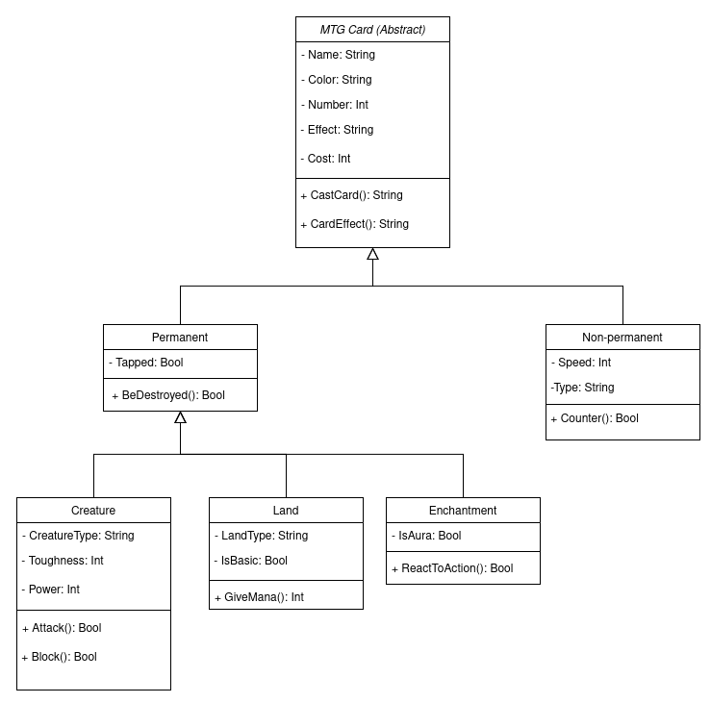
Heritage

Slide 8
Polymorphism
Override VS Overload

Slide 9
Helper Classes/Static Classes
-Can’t be instanced

